Slide 1


The lack of reproducible science in proteomics analyses – a bioinformatics perspective ASBCB Codeathon – October 2023
Coetzer, K.C¹, Adomako N.A^{1,4}, Ajiboye, I.O^{5,6}, Nortey H.³, Okello, O.I⁷, Aidoo, A.S², and Awe, O.I⁸
¹Department Biomedical Sciences, Division of Molecular Biology and Human Genetics, Stellenbosch University, Cape Town, South Africa
²Department of Virology, Noguchi Memorial Institute for Medical Research, College of Health Sciences, University of Ghana, Legon, Accra, Ghana.
³Department of Clinical Pathology, Noguchi Memorial Institute for Medical Research, College of Health Sciences, University of Ghana, Legon, Accra, Ghana.
⁴Department of Molecular Medicine, School of Medicine and Dentistry, Kwame Nkrumah University of Science and Technology, Kumasi, Ghana.
⁵Covenant Applied Informatics and Communication Africa Centre of Excellence (CApIC-ACE), Covenant University, Ota, Nigeria.
⁶Department of Computer and Information Sciences, College of Science and Technology, Covenant University, Ota, Nigeria.
⁷Department of Immunology and Molecular Biology, College of Health Sciences, School of Biomedical Sciences, Makerere University, Kampala, Uganda.
⁸African Society for Bioinformatics and Computational Biology, Cape Town, South Africa.

Slide 2
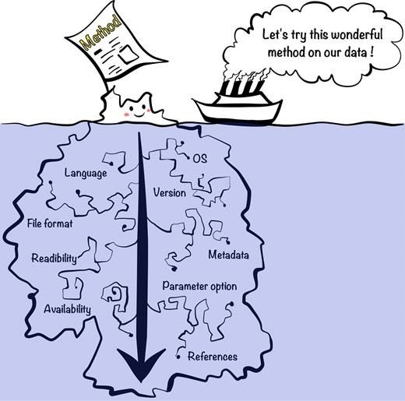
Proteomics and Reproducibility (or the lack thereof)
Proteomics is the study of the structure and function of proteins to understand an organism's nature.
Factors influencing reproducibility
In bioinformatics, research is reproducible when independent researchers can obtain consistent findings and conclusions using their own data, procedures, techniques, and codes.

Slide 3
AIM
Investigate the lack of reproducible proteomic analysis frameworks and methods in the literature

Slide 4
Methods and results
Literature Review:
Examine articles from diverse sources to assess the current research landscape.
Identify gaps in the development of standardized protocols and guidelines.
Failed attempt – many important articles missing
Identified proteomics analysis tools instead

Slide 5
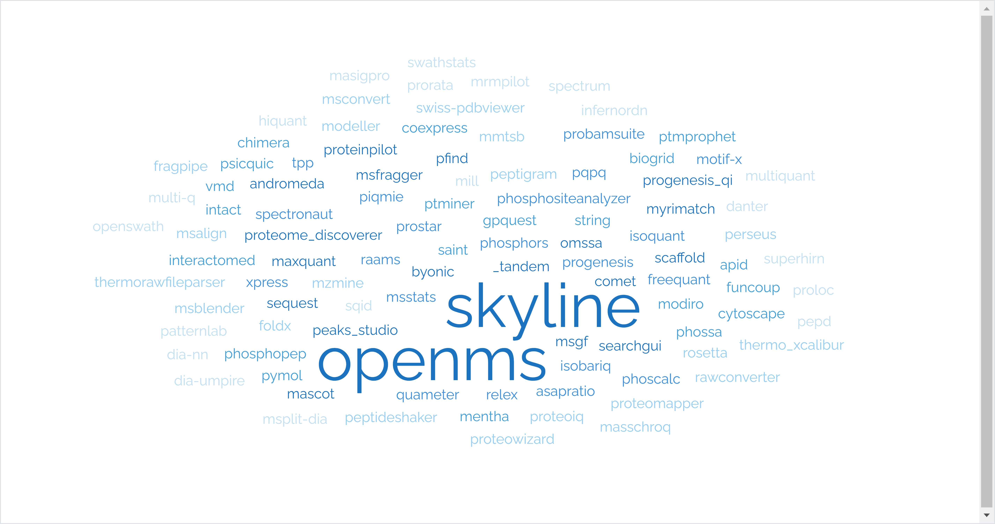
A search of tools
Category | Tools
Protein Identification and Peptide Identification | 15
Quantification and Labeling | 24
Post-translational Modification Analysis | 12
Protein-Protein Interaction Analysis | 12
Protein Structure Analysis | 10
Peptide Spectrum Matching and Visualization | 10
Mass Spectrometry Data Processing | 13
Data Visualization and Statistical Analysis | 21
DIA (Data-Independent Acquisition) Analysis | 9
Web-Based Tools and Resources | 13
Not an exhaustive list
Shows well-known and established tools

Slide 6
So, what is the problem?
Complexity of proteomics data and tools
Inadequate Documentation of Analysis Procedures
Lack of transparency and reporting
Publication Bias and Positive Result

Slide 7
What is currently being done?
Democratization of Bioinformatics
Containerized scientific Workflow Tools
Open-source code and data sharing - transparency
Flexible and scalable strategy

Slide 8
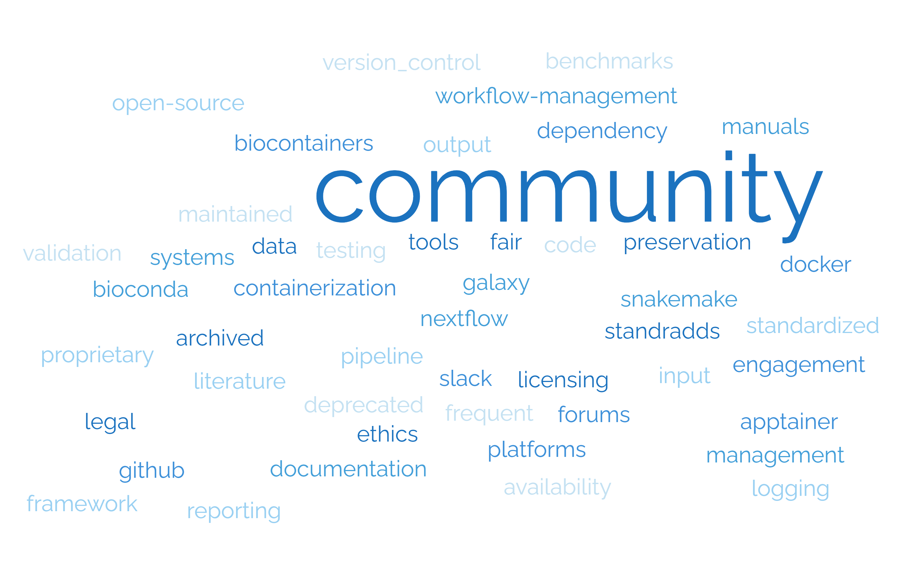
 | Criteria | Level 1 | Level 2 | Level 3
1 | Community standards adherence (FAIR principles) - based on 9 other criteria | Unknown or does not follow FAIR principles | Possibly follows some or all standards – not mentioned in the literature | Known to follow all community standards according to FAIR principles
2 | Preservation of data and software (Zenodo/Figshare) – archive software | Not archived | Archived data | Archived tool and data
3 | Version control - maintenance | No version control – tool is deprecated | No version control – tool still works | Complete version control
4 | Licensing and legal – for use and distribution as well as ethics – accessibility | Proprietary – requires payment or sign-up fees/ free trial | Open source but with limited usage or code is not available | Fully open-source and the code is available
5 | Community engagement (GitHub, Slack, forums etc.) | No community engagement | Some community engagement – 1 platform | Community engagement - >1 platform
6 | Assessing a validation against benchmarks or known standards | No testing was done at all/ unknown | Testing done on initial tool publication | Frequent testing done with updates
7 | Containerization (Apptainer, Docker, BioContainers) and Dependency management | Not containerized at all | Containerized as part of another tool or pipeline | Containerized
8 | Workflow management systems (Nextflow, Galaxy, SnakeMake) | No workflow management system used | The tool can be/is used as part of a pipeline in a workflow management system | A workflow management system is used
9 | Manuals, documentation, logging, and reporting | No manual, little documentation, logging, or reporting | No manual, good documentation, reporting or logging | Full manual, documentation, logging, and reporting
10 | Standardized input and output formats | Unknown | - | Formats can be converted to standardized inputs and outputs
A proposed reproducibility scoring system

Slide 9
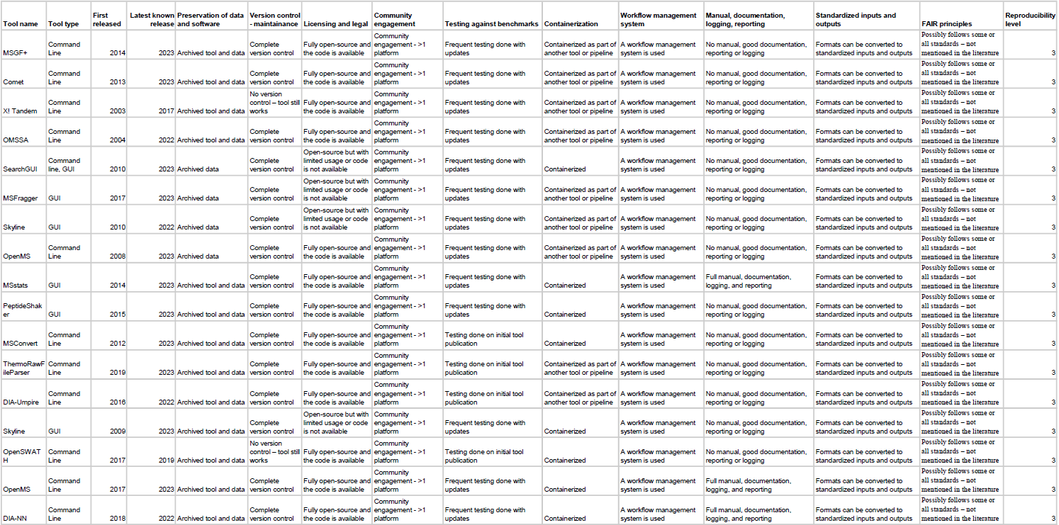
Best performing tools
Common characteristics:
Command-line
Frequently updated – well maintained
Good documentation/manual
Code can be edited – available on GitHub
Containerized in some way and uses some type of WMS
17/116

Slide 10
Areas for further improvement and research
Key Components to work on:
Efficient Evaluation of Large-Scale Data
User-friendly display and analysis
Containerized tools
Collaboration and engagement
Open-source data and code
The future…
Machine Learning
Deep Learning

Slide 11
Thank you
Any questions?

Slide 12
Additional slides

Slide 13
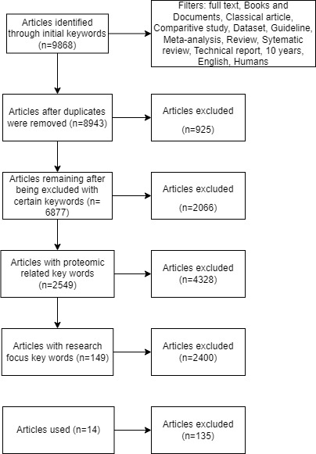
Initial literature search
Diverse Focus in Proteomics Studies:
Uncovered a diverse array of studies, each targeting various aspects of proteomics data analysis.
Keyword Search Shortcomings:
Noticed significant gaps in the keyword-based search, leading to the omission of crucial articles.
Lack of Standardized Keywords:
Discovered that a majority of articles lack the use of standardized keywords.
Consensus and Standardization Challenges:
Shed light on the notable absence of consensus and standardized practices, both in proteomics analyses and the reporting of these methods.
Only 14 “relevant” articles out of >9000

Slide 14
So which tools performed well?
DIA-NN
Level 3
OpenMS
Level 3
MSStats
Level 3

Slide 15
Reproducibility Scoring Approach:
We present a method to assess tools using a reproducibility scale.
Criteria for Evaluation: Tools are evaluated based on their capacity to produce consistent results and compatibility with diverse software platforms.
Benefits for Developers: Developers can pinpoint areas for enhancement and implement best practices.
Resource for Tool Selection: The scoring system serves as a valuable resource when choosing or developing data analysis tools

Slide 16
Common problems in these tools
No manuals, poor documentation
No containerization
Deprecated/ not maintained
Poor/no community engagement
Tools have very little or no documentation and is usually poorly written
VERY few tools are containerized and have many dependencies, making installation and running difficult
Many tools are not useable anymore

Slide 17
Preprocessing Data
Data Quality Assessment
Challenges in Ensuring Reproducibility in Proteomics
File Formats and Data Sharing
Lack of Detailed Documentation
Software Tools and Algorithms

